Slide 1
Systems Analysis Tools
DFDs, Context diagrams and CASE Tools

Slide 2
What are System analysis tools?
These are used to give a better understanding of a system or how you can meet a set of objectives
It examines any current systems and how you could modify them
It analyses the requirements and whether you need to create a new system
CASE tools are often used

Slide 3
CASE Tools
Flowcharts
Data flow diagrams
Context Diagrams
UML and SSADM
Gantt Charts
Technical and end user documentation
Requirements Analysis
Pseudocode
Prototype or snippets of code

Slide 4
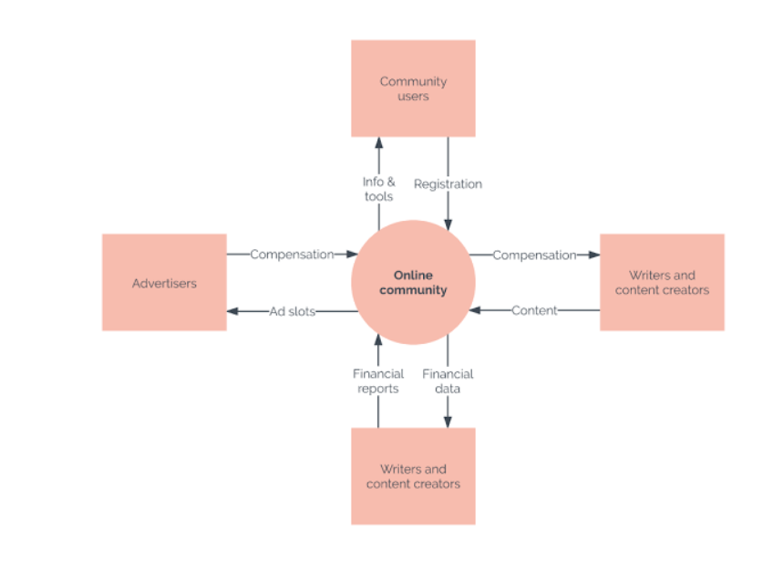
Context Diagrams
These diagrams help to understand the context and boundaries of a system.
It gives an overview of how the system works for anyone involved with it.
It is also the first level of a Data Flow Diagram (DFD LEVEL 0)

Slide 5
Symbols used in DFD
External Entity
External entities are objects outside the system like actors, with which the system communicates.
External entities are sources and destinations of the system's inputs and outputs.
Dataflow
Dataflow are pipelines through which packets of information flow. Label the arrows with the name of the data that moves through it.
Process
A process transforms incoming data flow into outgoing data flow.
Data Store
Holds information for later use

Slide 6
Activity
Use Microsoft Visio or https://app.diagrams.net/ to draw your diagrams
Create a context diagram for the following scenario:
Online Clothing Shop

Slide 7
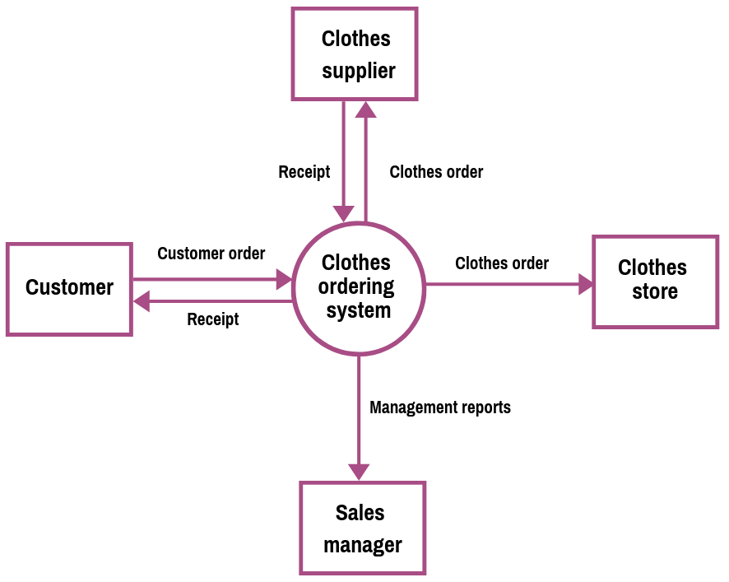
A sample solution…

Slide 8
Data Flow Diagrams (DFDs)
Maps out the flow of data throughout the system
A more detailed version of a context diagram
DFDs have different levels

Slide 9
DFD Rules
Each process should have at least one input and an output.
Each data store should have at least one data flow in and one data flow out.
Data stored in a system must go through a process.
All processes in a DFD go to another process or a data store.

Slide 10
DFD Levels
DFD Level 0 = context diagram
DFD Level 1
DFD Level 2

Slide 11
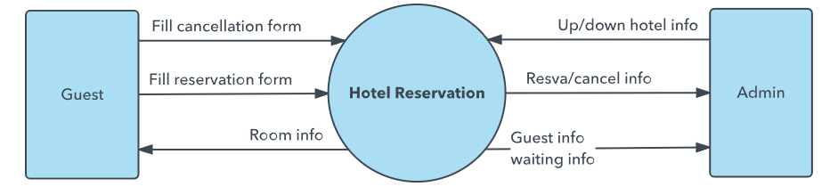
DFD LEVEL 0 (Context Diagram)
A basic overview of the whole system which can be understood by anyone involved in the system

Slide 12
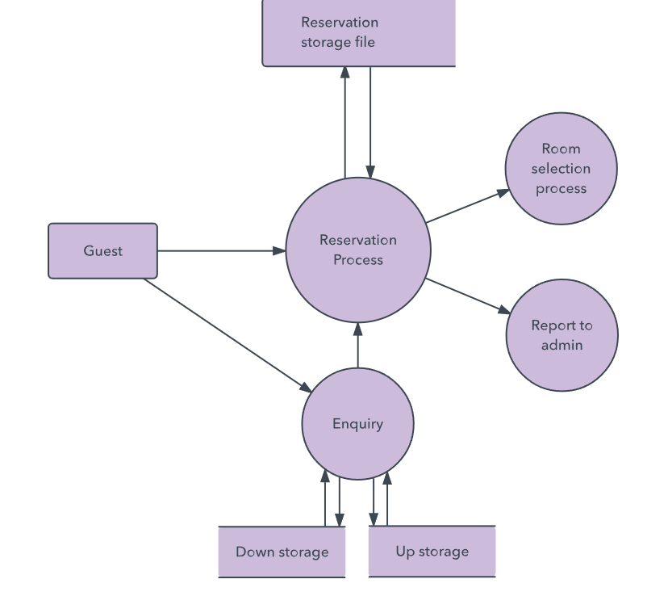
DFD LEVEL 1
This level highlights the main functions of the system

Slide 13
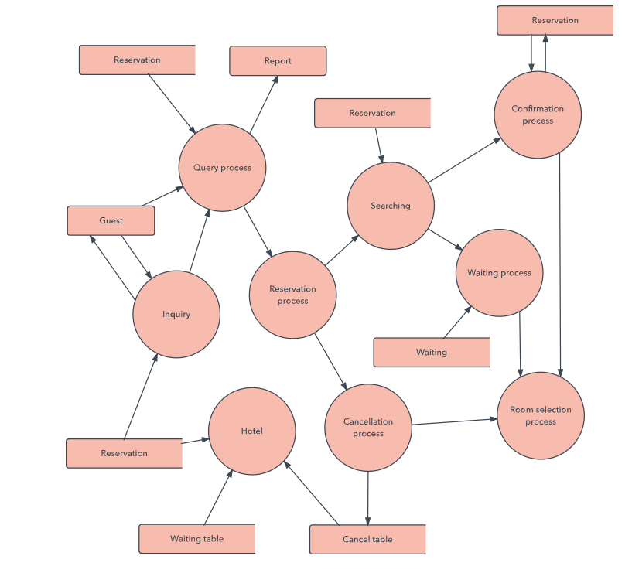
DFD LEVEL 2
This level goes into more details from the functions in Level 1

Slide 14
Activity
Use Microsoft Visio or https://app.diagrams.net/ to draw your diagrams
Following on from the previous context diagram that you drew of the clothing store create the rests of the DFD level diagrams.

